Slide 1
Two IMAGE PROCESSING ALGORITHMS
Brightness
Gama correction
Maja vukasović
2012/0003

Slide 2

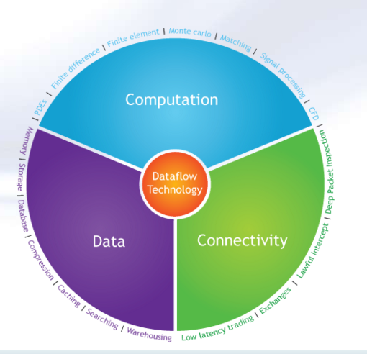
Maxeler
Dataflow paradigm
The write to the memory is postponed until the data processing is finished
Decreases cost of reading and writing temporary results
Tokens on the entry points of vertices in a graph are a condition for operation completition
Loop oriented, big data
As less data dependences as possible

Slide 3

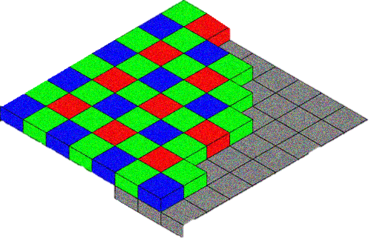
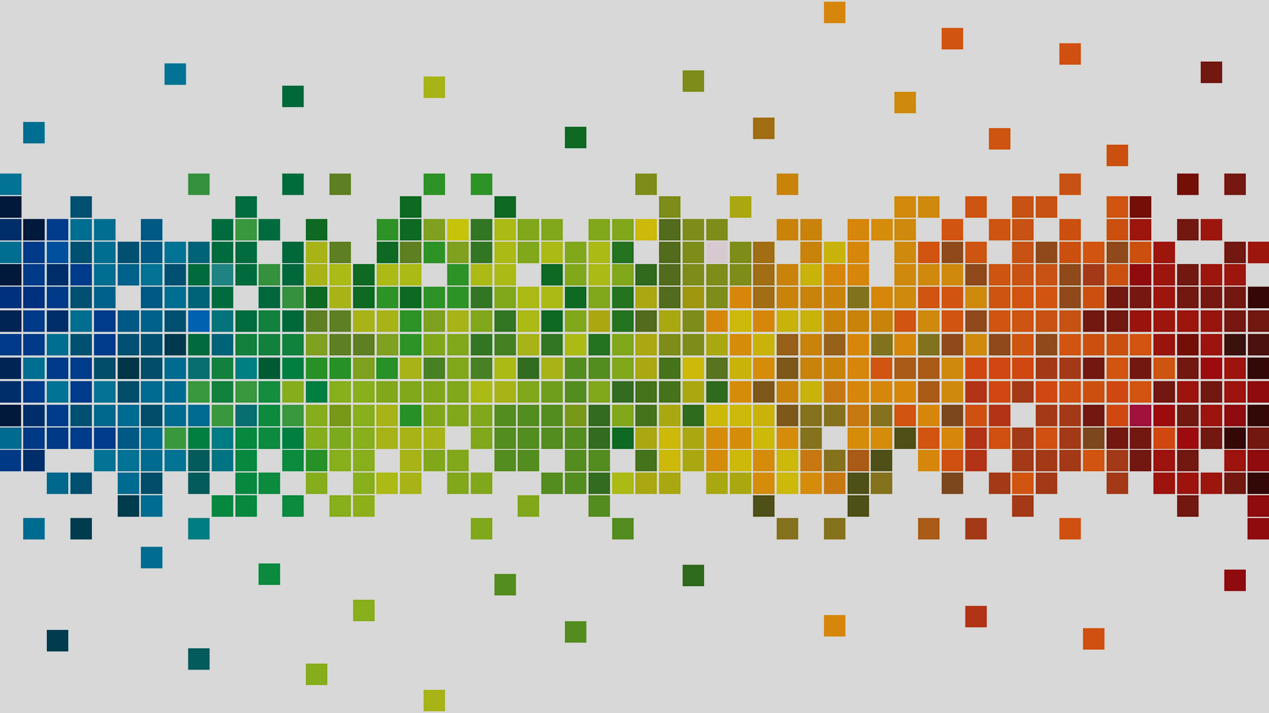
IMAGE PROCESSING
Embarrassingly parallel problem
RGB format of pixels
Different formats: jpg, png, ppm, bpm, ...
/16

Slide 4
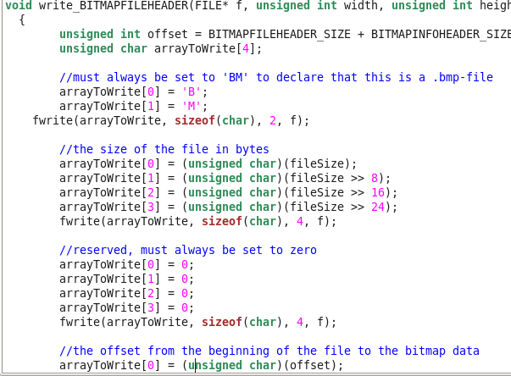

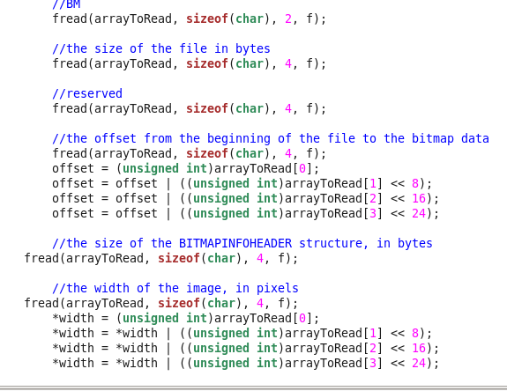
/16

Slide 5

The Brightness algorithm
Attribute of visual perception in which a source appears to be radiating or reflecting light
Perception elicited by the luminance of a visual target
colour = GetPixelColour(x, y)
newRed = Truncate(Red(colour) + brightness)
newGreen = Truncate(Green(colour) + brightness)
newBlue = Truncate(Blue(colour) + brightness)
PutPixelColour(x, y) = RGB(newRed, newGreen, newBlue)
If value < 0 Then value = 0
If value > 255 Then value = 255

Slide 6
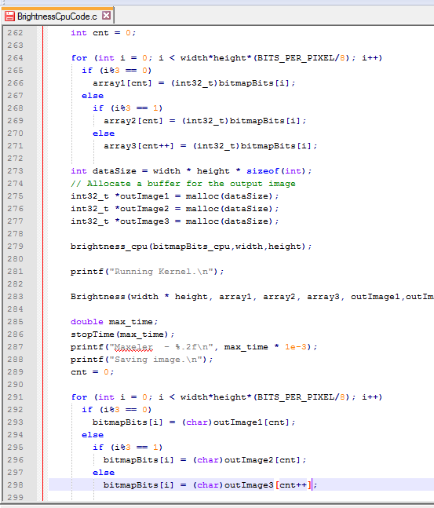
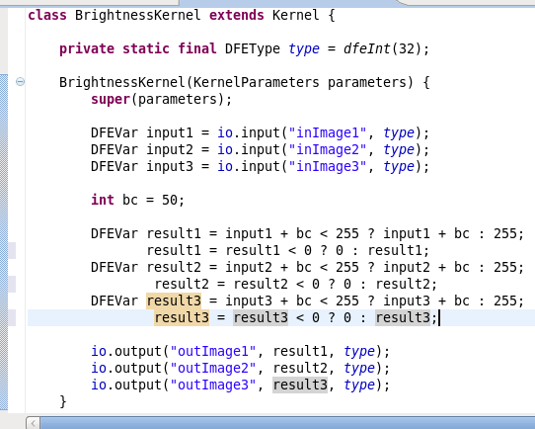
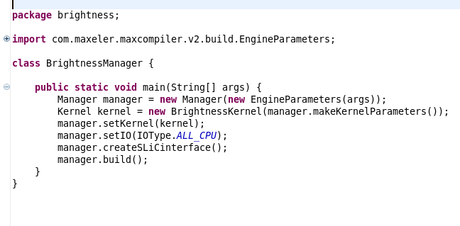

Slide 7
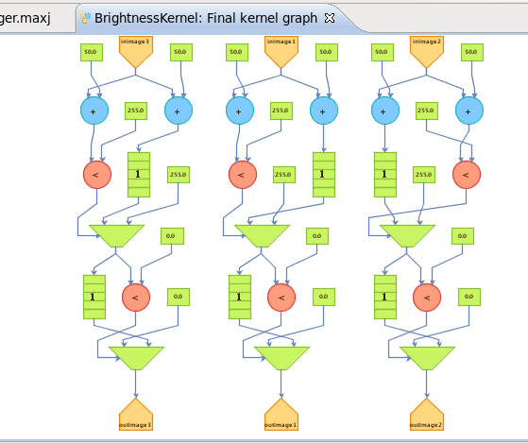
The Brightness algorithm GRAph

Slide 8
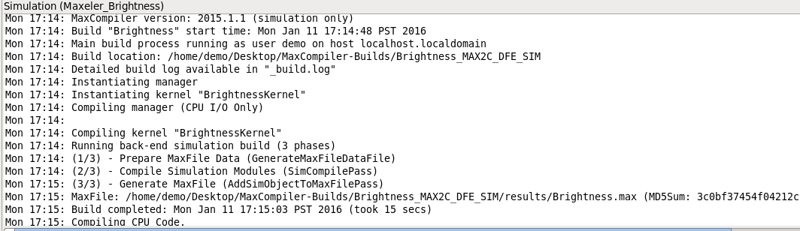
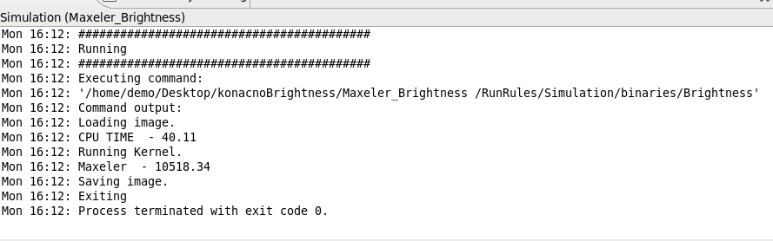

Slide 9
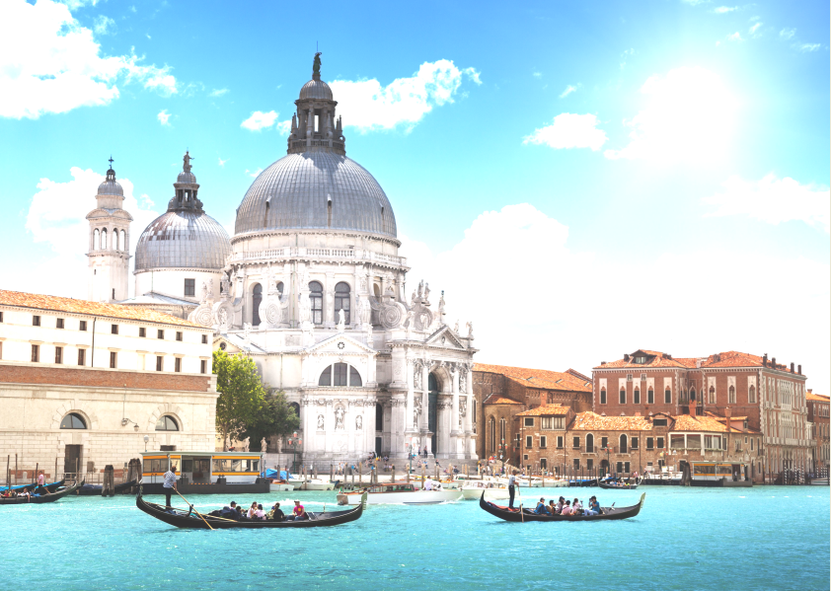
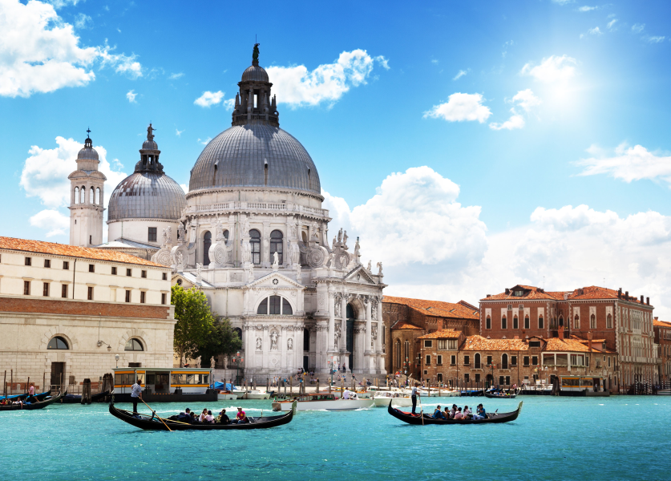
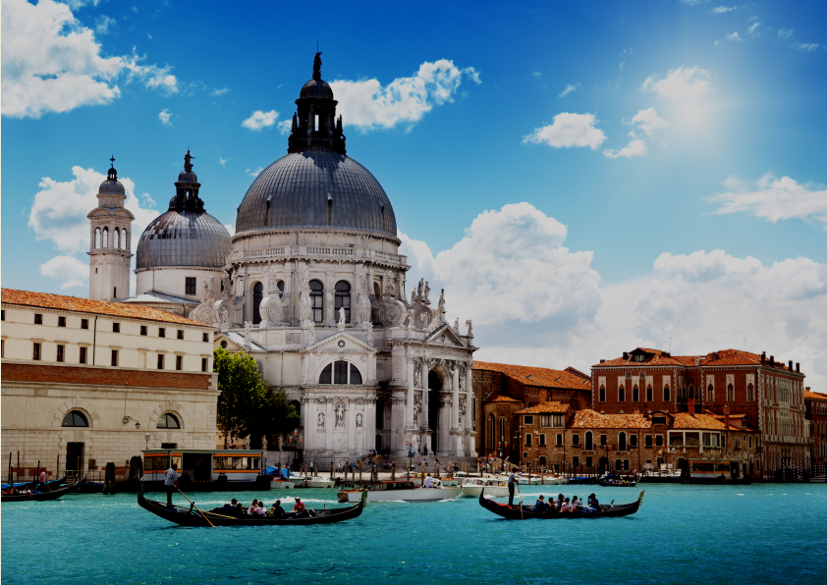

Slide 10
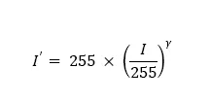
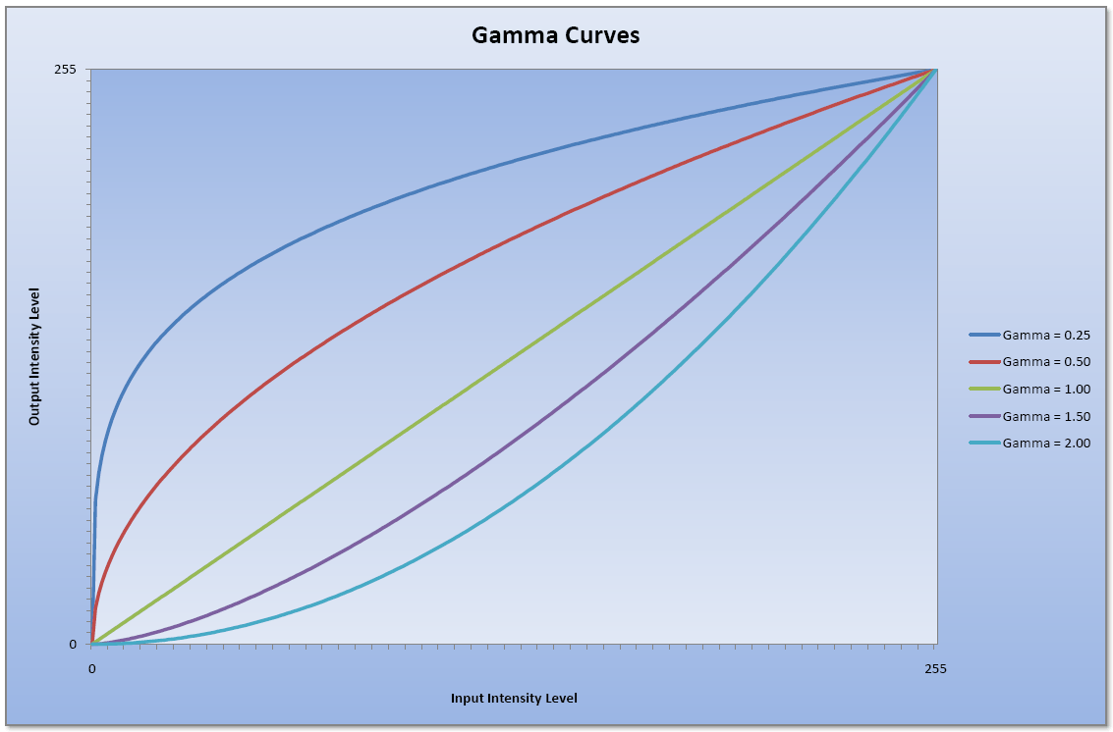
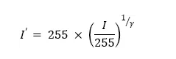
The Gamma correction algorithm
Gamma – relation of the input and output pixel value
It affects the RGB components value
Reciprocal value – gamma correction

Slide 11
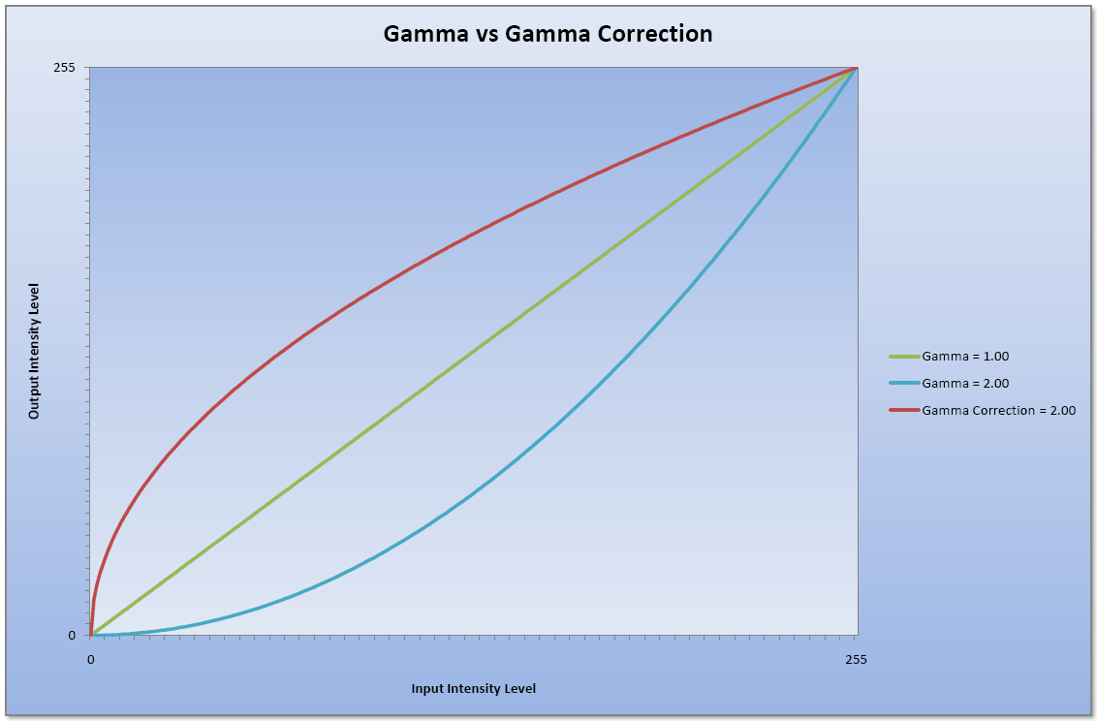
The Gamma correction algorithm (2)
gammaCorrection = 1 / gamma
colour = GetPixelColour(x, y)
newRed = 255 * (Red(colour) / 255) ^ gammaCorrection
newGreen = 255 * (Green(colour) / 255) ^ gammaCorrection
newBlue = 255 * (Blue(colour) / 255) ^ gammaCorrection
PutPixelColour(x, y) = RGB(newRed, newGreen, newBlue)

Slide 12
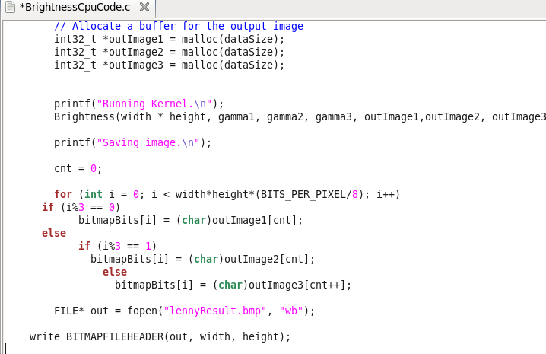
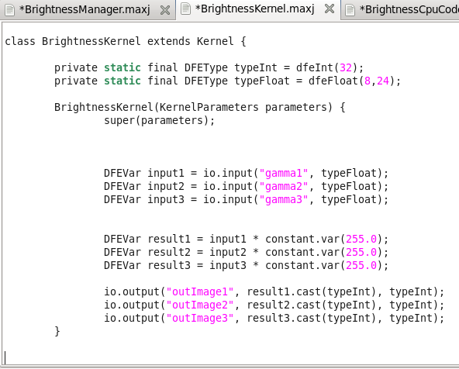

Slide 13
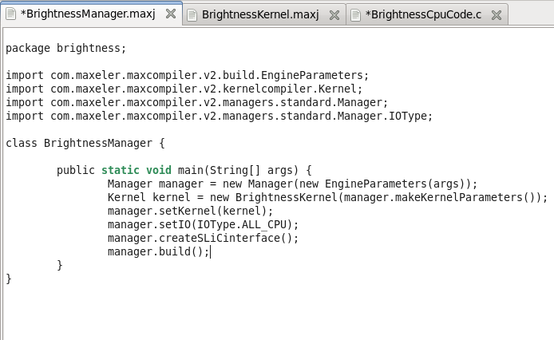
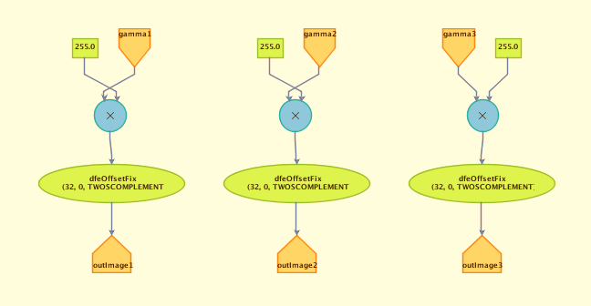
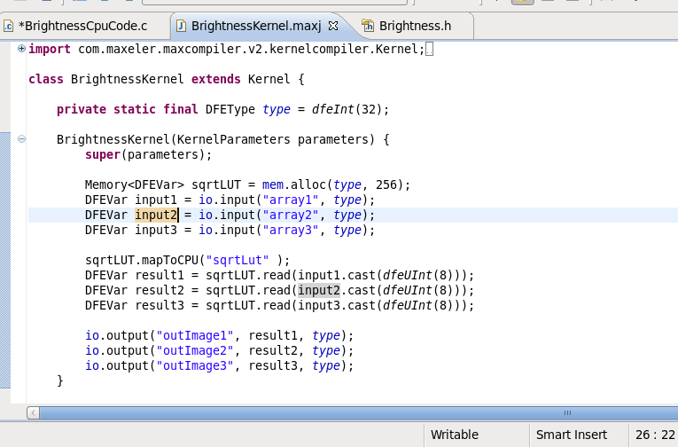

Slide 14
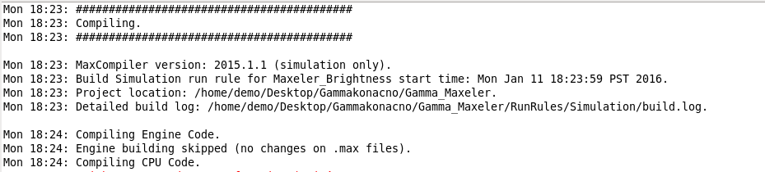
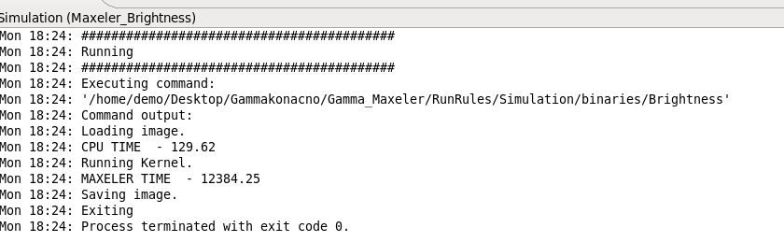

Slide 15
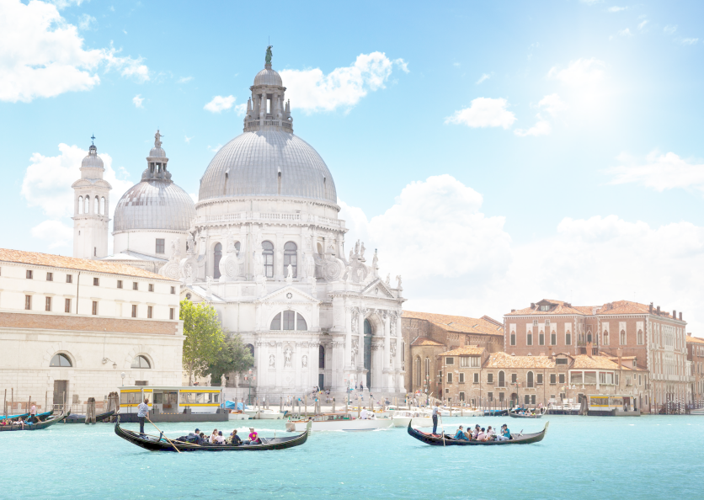

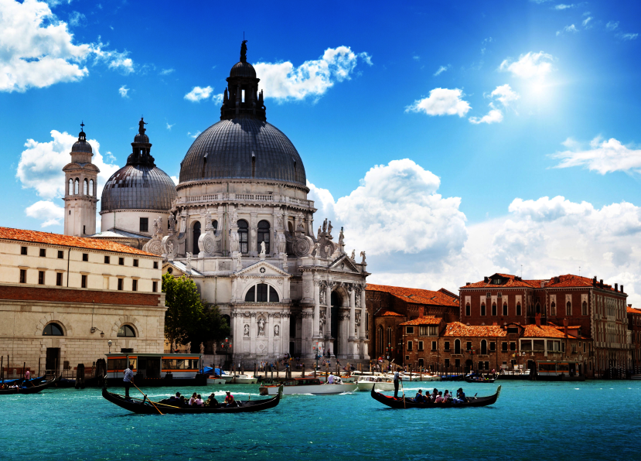

Slide 16
references
Milutinovic, V., et al, Guide to DataFlow SuperComputing, Springer, 2015.
Milutinovic, V., Salom, J., Trifunovic, N., Giorgi, R., "Guide to DataFlow SuperComputing," Springer, 2015.
https://en.wikipedia.org/wiki/Gamma_correction
http://www.dfstudios.co.uk/articles/programming/image-programming-algorithms/image-processing-algorithms-part-6-gamma-correction/
https://en.wikipedia.org/wiki/BMP_file_format
http://www.dfstudios.co.uk/articles/programming/image-programming-algorithms/image-processing-algorithms-part-4-brightness-adjustment/

